Slide 1
ROBOT TEAM 2 POWERPOINT PRESENTATION

Slide 2


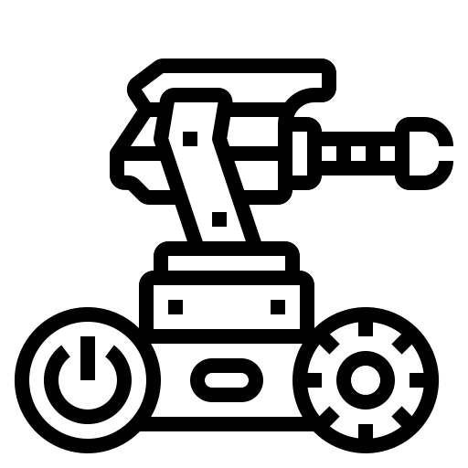



Makenzie Roberts
Tyler
Dinn
David Turner
Lead Project 3
( )
Lead Project 1
(System Design)
Lead Project 2
(Some Python Code)
Robot Obstacle Course
Provided solutions & guidance on the other projects
Provided solutions & guidance on the other projects
Provided solutions & guidance on the other projects

Slide 3

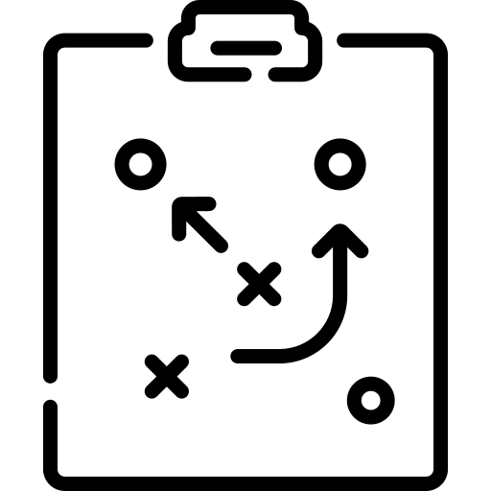



Project Management Strategy
Trello was used to keep track of each task. We had a To-Do Board, a board for each team member, and a board for Completed tasks. To accurately display our progress, we also used check-lists for sub-tasks.
Most mornings around 10:30am we would have a stand-up meeting call/text chat through Microsoft Teams. Some days we would have another meeting at night to update the team on our progress and get help/guidance with any issues we had faced.
We used a Github repository to share files among the team. We also used Microsoft Teams for sharing code snippets/images for troubleshooting or sharing our progress.
Trello: https://trello.com/b/pLqWg9gL/sprint-2
Github: https://github.com/DeToxFox/Grp22A-2-Final-Spint-Week

Slide 4





Major Challenges
Largest obstacles we faced during this project
Missing one team member
Transportation issues/difficulty getting to the campus
Two or three work-days were underutilized due to sickness
Time management
The robot course made troubleshooting code very slow. If you changed your code overnight, you’d have to come back to the course to test it again, resetting the robot’s position each time.
How to mitigate these challenges in the future
It may help to test each room of the course until completion, versus trying to run the whole course each time.
Set realistic completion goals and make sure there’s ample time for review.
Set alarms/timers to keep track of how long we’ve been working on a project. Sometimes it’s easy to get carried away adding features, so being reminded of the time can help you prioritize.

